Slide 1
Understanding Long-term Evolution and Lifespan in Peer-to-Peer Systems
Yong Zhao, Zhibin Zhang, Li Guo
Institute of Computing Technology,
Chinese Academy of Sciences
zhaoyong@software.ict.ac.cn

Slide 2
Motivation
Low availability in P2P systems
80% swarms are unavailable in 80% time
Mechanisms without the navigation of models
Limited effect
Notes:
Nowadays, more and more content providers adopt peer-to-peer
system to deliver their files. Although the feature of self-organizing
can quickly organize a massive of peers to share file content,
the volatility of peer-to-peer swarms lead to a short lifespan.
According to the result of Daniel et al., almost 80% of swarms were unavailable 80% of time
[2]. Surprisingly, the long-term evolution and lifespan is rarely
mentioned except a few recent works aim to design effective
incentives for seeds that keep seeds staying longer time in
swarm.
Previous models [4] [5] either
focus on the flash-crowd or are on the basis of short term
swarm characteristics. They can’t look the swarm at a bird
view and point out the general factors of lifespan. Therefore
a long-term model is needed to guide us on designing better
seed incentives.

Slide 3
Limitation of Prior models
Unrealistic assumptions
Redundant uploading
Peer leave rate is variable
Multi-participation of peers
Notes:
Before modeling swarm, we need to think about it in a
long-term view. Previous models are based on short-term
characteristics and some of their assumptions conflict with
long-term characteristics. First, there is redundant uploading
bandwidth.
Recent literature and our measurement show that the seed
to leecher ratio keeps in a high level after flash-crowd. So
the uploading bandwidth is bigger than the downloading one
in long lived swarms. Second, the peer leave rate is variable
while time elapses. Although assuming leave rate as a constant
is fine in short term models, it will cause apparent error in
large time scale. Last, the life cycle of peer is an alternating
process between online and offline. According to our
results, peer usually participates in a swarm many times on
average.

Slide 4
Long-term model
Task
Definition: We call the procedure from a peer starts the downloading to it deletes the torrent a task. It is the series of participation of the same peer.
Arrival rate:
Peer availability: the proportion of online session in the task length
Task length: exponential distribution
Notes:
There are four basic factors of swarms based on the long-term
life cycle of peers. The first two factors are about peer
arrive rate. \lambda_0 is the arrive rate when swarm born, and \tau is
the attenuation parameter of arrive rate. We believe that the
fundamental reason of swarm’s dead is the declining arrive
rate. The third factor is the availability of a peer which can
be calculated from the online session length and the offline session length.
For the peers are independent and obey the same distribution,
we assume all peers have the same availability. The fourth
factor is the task length. In our model, the peer leave rate is
not explicitly involved. In fact, the leave rate is a function of
arrive rate and task length.

Slide 5
Long-term evolution
Evolution:
The mixture of every peers’ lifecycle
Lifespan:
When the average number of active peers is below a threshold, such as one, the swarm dies.
Notes:
In order to depict long-term evolution, we compose each
peer’s behavior to represent the whole swarm. Peers arrive
to the swarm following an exponential rate and they alternate
their status between online and offline until leaving the swarm
permanently. We mix every peer’s life cycle to form the
swarm evolution in our long-term model. In order to obtain
the lifespan, we assume the swarm will die when the average
peer number is below a threshold, such as one.

Slide 6
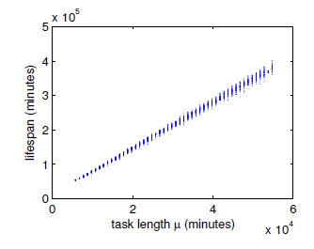
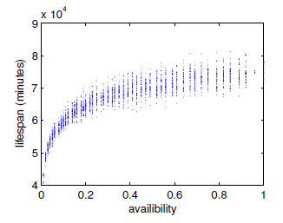
The influence of lifespan
Linear influence: task length, attenuation parameter
Logarithmic influence: peer availability, initial arrival rate
Notes:
Our model enables us to analyze the key factors that influence
lifespan. According to our model, there are four factors
that influence lifespan in two kinds of different ways. One kind
of factors is the attenuation parameter of arrive rate and the
average task length that influence lifespan linearly.
The other kind
of factors are the initial arrival rate and peer availability that
have logarithmic influence on lifespan.
In summary, seed incentives are not the only way to extend lifespan.
We then validate our model
and results with real swarm and simulations. Our experiments
show that the model captures the evolution closely and the
results are valid in different situations.

Slide 7
Conclusions
Perspective: micro view VS. macro view
Model: Peer VS. Task
How different factors influence the lifespan
Notes:
To the best of our knowledge, there is no conclusion about which fundamental factors influence
it. In order to give a clear result, we inspect long-term
characteristics by measurements. The new
findings in measurements are different from the work that based on short
term characteristics. So we propose a long-term model which
ignores detailed changes in short term to give a clear view
about the long-term evolution. Although we make several
simplifying assumptions, the model fits real swarm very well
and the results are validated by extensive simulations.

Slide 8
Thanks For Attention Q & A

