Slide 1
Performance and Power Analysis on ATI GPU: A Statistical Approach
Ying Zhang, Yue Hu, Bin Li, and Lu Peng
Department of Electrical and Computer Engineering
Louisiana State University, LA, USA

Slide 2
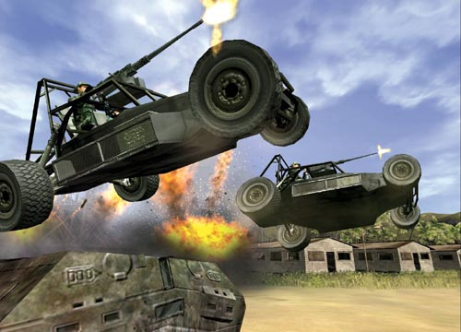
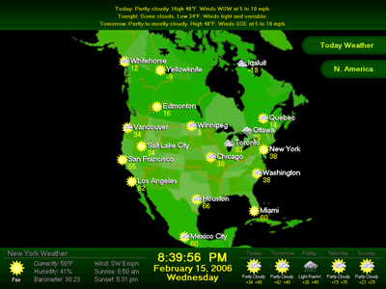
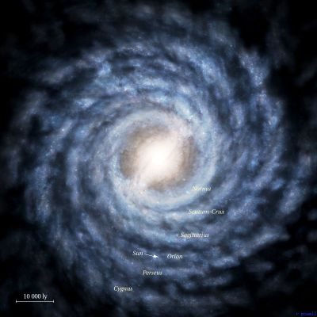
GPUs are important nowadays
Entertainment
Sophisticated computer games
High Definition Videos
Gpu
cpu
Scientific Computation
Biology
Aerography
Astronomy
Lots of …..
Notes:
GPUs are very important in the current PC industry. In our daily life, people wanna their computers to be capable of handling sophisticated computer games, and playing high definition videos. Traditional CPUs are not able to do this. In scientific computation domain, large-scale computings are important. Here I show three pictures, you may easily recognize that they represent the biology (DNA sequencing), aerography (weather forecast), and astronomy (star cloud). If we use modern CPUs to run these applications, we may have to wait for unreasonable long time (several months). Therefore, GPUs, which consist of thousands of cores, are utilized. The cartoon on the right demonstrate this idea. GPU can solve these problems much faster than CPU.

Slide 3
Prior studies on GPUs
Performance
[1] [2] explore Nvidia GTX 280 using microbenchmarks
[3] [4] analyze GPU performance with well-built models
Power & Energy
[5] introduce an integrated model for performance and power analysis
[6] predicts power from performance metrics
[7][8]attempts to investigate the energy efficiency of different computing platforms
Notes:
This lists some prior studies on the modern GPU. I generally classify them into two categories: studies on performance and those on power/energy.

Slide 4
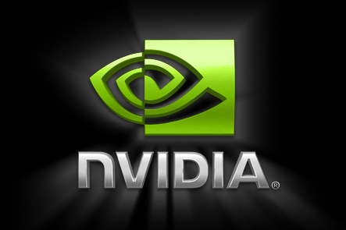
Our study
Most of previous work focus on Nvidia’s design!
ATI GPUs are different. Can we obtain new findings?
Statistical analysis tool
Performance
[1] [2] explore Nvidia GTX 280 using microbenchmarks
[3] [4] analyze GPU performance with well-built models
Power & Energy
[5] introduce an integrated model for performance and power analysis
[6] predicts power from performance metrics
[7][8]attempts to investigate the energy efficiency of different computing platforms
Microbenchmarking based study usually focuses on few well-known components
Overall Picture
Microbench
Detailed investigation on key factors
GPU performance/power profile
Our target: a recent ATI GPU
Notes:
Take a look at these listed references. We notice that most of them focus on Nvidia GPUs. However, as another important GPU manufacturer, ATI’s products have not been gained too much attention. As we will show shortly, ATI GPUs have many architectural difference from typical Nvidia designs. This justifies that the study on ATI GPUs are also promising. Therefore, we choose a recent leased ATI GPU as our target device in this work.
Second, lots of the previous works are conducted by using pure micro-benchmark based approach (especially in performance analysis paper). This approach is useful to investigate the well-known components of a given hardware. For example, the cache access latency, cache size, line size, TLB size, etc, can be measured by well-designed benchmarks. People then use those results to analyze the performance of a device. however, some components may be missed when using this method. For a given new hardware, we cannot say which part is more important than others by intuitive. Therefore, we employ the statistical model based methodology. With this approach, we take account of all the possible influential factors and first build an overall picture of the target device with the help of the statistical tool. We then identify the most important parts and conduct more detailed study on these key components.

Slide 5
Contributions
Correlating the computation throughput and performance metrics
Relative importance of different metrics
Partial dependence between the throughput and metrics
Identifying decisive factors to GPU power consumption
Find out variables that pose significant impact on GPU power
Extracting instructive principles
Propose possible solutions for software optimization
Point out hardware components that need to be further upgraded
Notes:
In general, our work make these contributions (as listed)

Slide 6
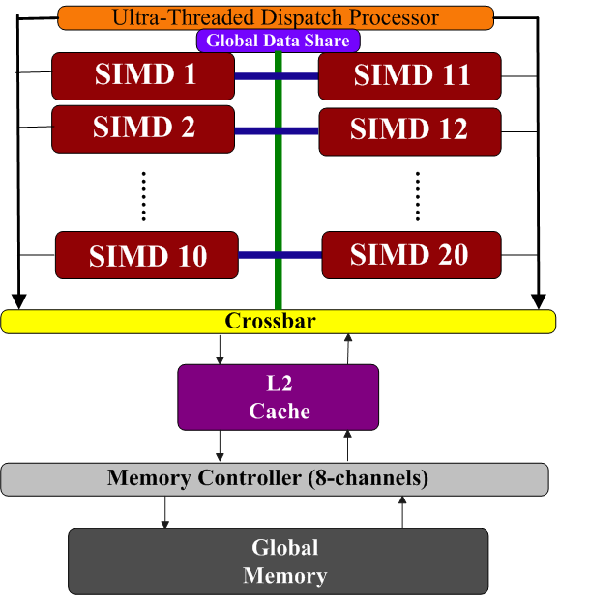
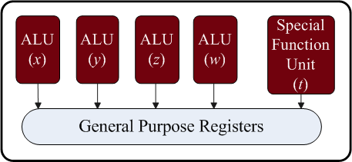
Target GPU- ATI Radeon HD 5870
SIMD Engine
Thread Processor
Notes:
The GPU used in this study is an ATI Radeon HD 5870, codenamed Cypress.
Its general architecture is demonstrated in this figure. We can see that there are 20 Single-instruction-multiple-data (SIMD) execution engines. All the computations take place in this part, so it is very important . The memory hierarchy includes an L2 cache and the global memory. All the SIMDs are connected to the L2 cache via a crossbar. There is also a ultra-threaded dispatch processor on the GPU, which is responsible for managing and assigning the large amount of threads to different SIMDs at runtime.
If you have knowledge about Nvidia GPUs, you may find that the SIMD here is sort of similar to a stream multiprocessor (SM) on an Nvidia GPU. However, their internal architecture is different. This figure shows the architecture of an SIMD engine on the target GPU. Inside it, there are 16 thread processors (TP), a 32kB local data share (similar to the shared memory on Nvidia GPU), a texture unit with 8KB L1 texture cache (read-only). The difference between this design and an Nvidia SM majorly comes from the thread processor, which is shown in this picture. ATI adopts the very long instruction word (VLIW) architecture to organize its thread processor. Each thread processor is five-way, meaning there are five function units inside. ATI refer these five units as x,y,z,w,t. The x/y/z/w are regular arithmetic units. They can conduct floating point/integer add, mul, etc. The t unit is introduced as a special function unit. It can perform regular ALU instructions as well as complex instructions such as sin/cos/exp/log, etc. As any VLIW processor, data-independent instructions can be assigned to these five slots and be executed simultaneously.

Slide 7
Random Forest Model
Accurately capture the decisive factors from numerous input variables
Ensemble model consisting of several regression trees
Provides useful tools for analysis
Relative variable importance
Partial dependence plot
Use Leave-one-out-cross-validation
Repeatedly choose one sample as validation and others as training
Notes:
In this work, we employ the random forest statistical model to facilitate our study. It can capture the key factors from a large amount of input variables. This is exactly what we want.
It is composed of many regression trees.
In addition, it provides us two useful tools to better understand the relation between inputs and the metric in interest: relative variable importance, quantify the impact of each factor on the output; partial dependence plot, visualize the relation between a specific input and the output.
We use the leave-one-out-cross-validation (LOOCV) to do the validation. That is to say, we choose a sample from the input space and use it as the validation sample, all others are treated as training samples. We do this repeatedly until each sample has been iterated.

Slide 8
Experiment setup
Testbed
A computer equipped with an ATI Radeon HD 5870
ATI Stream Profiler v2.1 integrated in MS Visual Studio 2010
BenchMarks
OpenCL benchmarks from ATI Stream SDK
Other equipments
Yokogawa WT210 digital power meter
Notes:
Our studies are conducted on a computer equipped with an ATI Radeon HD 5870 GPU. We run the OpenCL benchmarks from the ATI stream SDK for our analysis. The ATI toolkit provides us a visual profiler, which can be integrated in Microsoft Visual Studio 2010, for the performance analysis. When this tool is enabled, we can collect several execution statistics of a OpenCL kernel. For the performance analysis, we use millions of instructions per second (MIPS) as the metric. For the power monitoring, we use a Yokogawa WT210 digital power meter.

Slide 9
Overall Procedure
Target system
Performance profile
Random Forest
Performance model
Power
model
Power consumption
Power meter
Notes:
In general, the working procedure of this study is like this. First, we connect the power meter to the target system where the OpenCL benchmarks are running. For each benchmark, we can read its power consumption (GPU power, excluding CPU and other components) from the meter and collect execution statistics from the performance profiler. The profiler reports information such as cache hit ratio, memory accesses info, number of registers allocated to the kernel, and so on. For the performance model, we input those info to the random forest tool. Note that these info are used as inputs while the corresponding MIPS is the output. Similarly, for power model training, we just need to replace the output to the measured GPU power consumption.

Slide 10
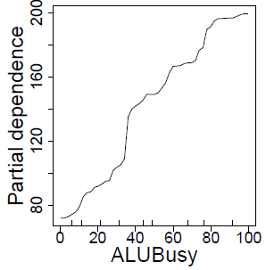
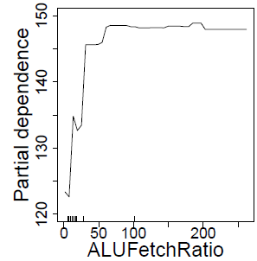
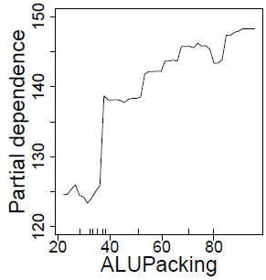
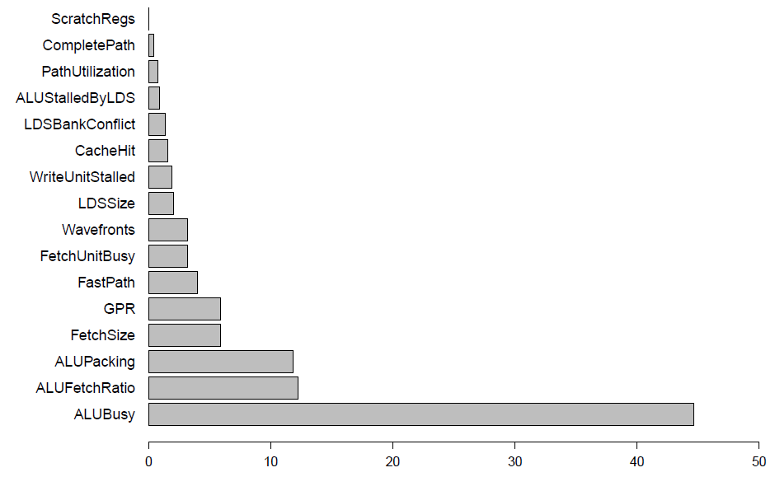
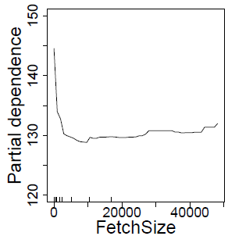
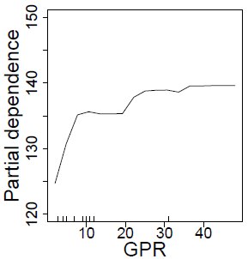
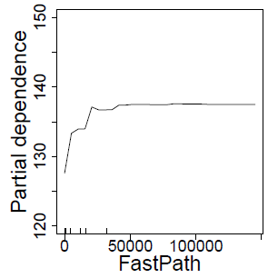
Performance Characterization
Notes:
The random forest tool can calculate the relative importance of each input variable. We demonstrate the importance to the performance in this figure. Usually we only concentrate on the most significant variables with high rankings, because the factors positioned afterwards do not pose much impact on the output value. We see that ALUBusy, ALUFetchRatio, ALUPacking, FetchSize, GPR, and FastPath rank as the top six important variables. Especially, for ALUBusy, its importance almost reaches around 45%. This is not surprising because higher ALU utilization means more instructions are executed within a given time. ALUFetchRatio is calculated by #ALU op/#global fetch op. If this value is very small, it means the program always need to load data from the global memory and conduct little computation on it, and do global fetch again… In cases where the parallelism is not good enough (#work-groups assigned to an SIMD is small), such frequent global memory accesses tend to harm the performance. ALUPacking is also important to VLIW execution, this is quite straightforward. Fetchsize and GPR… nothing special. FastPath is a special hardware on the ATI GPU, we will give more analysis soon.
In addition to know the importance, we also want to see how these factors impact the overall performance. Therefore, we also plot the partial dependence between these six factors and execution throughput. As we expected, when ALUBusy increases, performance increases. The same for ALUFetchRatio, and ALUPacking…. The counter FastPath denotes the number of bytes written to GDDR through the fastpath. This counter also positively impact the performance.

Slide 11
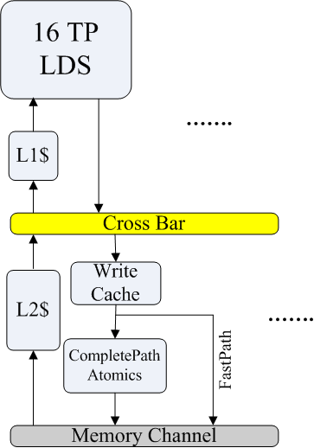
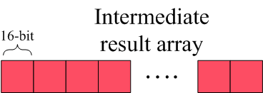
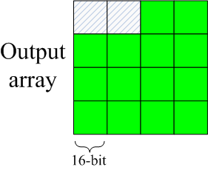
Make better use of the FastPath
Both Paths are write path
Fast Path
Efficient
Support non-atomic 32-bit ops
Complete Path
Much slower
Support atomic and other ops
Notes:
This picture shows the memory architecture of the target device in more detail. Note that the down-side arrows indicate write paths while the up-side arrows are read paths. We see that in between the write cache and the memory channel, there exist two paths: complete path and fast path. The fastpath has much higher transfer speed than the complete path, but it only supports non-atomic 32-bit type stores. On the contrary, the completepath support atomic operations, and sub-32-bit write operations. The compiler decides which path a store instruction will go through, depending on the data type.
To better demonstrate the difference and show how this can be used for performance optimization, we show an example. This array (red rectangles) contains the intermediate results which are going to be stored in the output array (green). Suppose the types of these two arrays are set to short (16-bit). We also suppose each work-item is responsible for storing one element. In this case, the store operations will go to the global memory via the complete path because the data type is 16-bit. However, if we combine two work-items into one, the data to be stored becomes 32-bit. By doing this, the write will go through the fastpath. Of course in this case, the output array also needs to be changed to 32-bit type (this may introduce post-process, which can be easily done on the CPU). Our experiment shows that the kernel execution can be speed up by 23% after the modification.

Slide 12
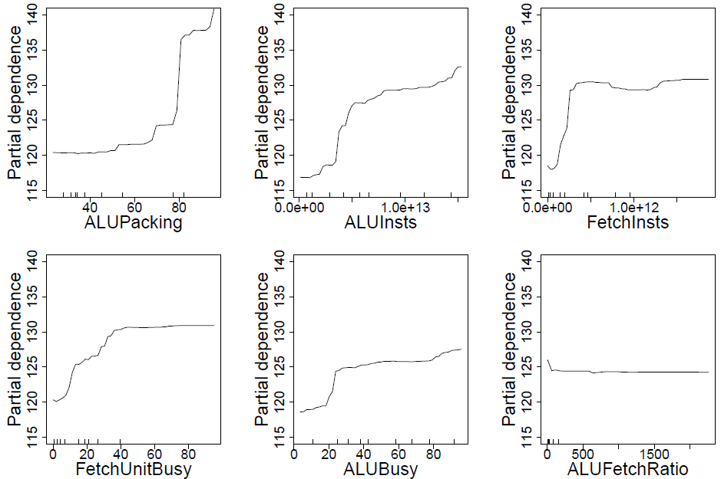
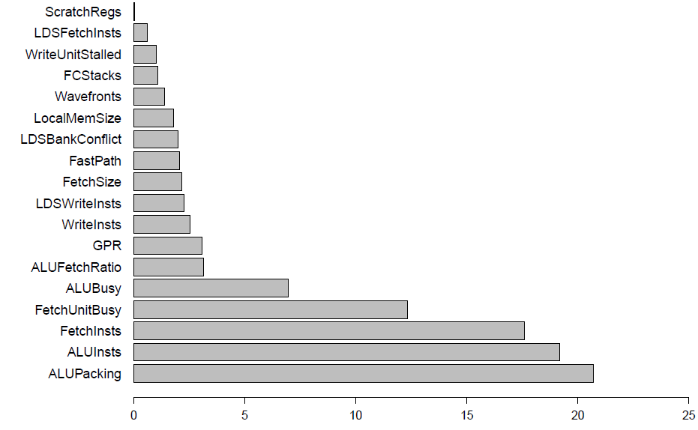
Power Consumption Analysis
Notes:
We analyze the power consumption features in a similar way. Here the picture shows the relative importance of all the variables. As we can see, the ALUPacking stands as the most decisive factor, while ALUInsts, FetchInsts, FetchUnitBusy, ALUBusy ranks from 2nd to 5th. ALU packing reflects the number of slots that are utilized within a VLIW. It is easy to understand that the higher the ALU packing is, the larger the power consumption will be. ALUInsts/FetchInsts/FetchBusy/ALUBusy reflects the utilization of ALU and fetch unit; therefore, when these counters are increasing, the power is also increasing.
The partial dependence generally validates our analysis. However, we wanna pay more attention to the most important factor, ALUPacking, because it is a special metric to evaluate the VLIW execution efficiency. From the first plot, we see that when the packing ratio achieves 80%, there is an obvious step-up in the power consumption. (shown by a red arrow). Is there anything can be revealed here? We need to do some studies here.

Slide 13
Case study on packing ratio
Packing ratio - Utilization of the 5-way VLIW processor
More power-consuming?
100% packing ratio
80% packing ratio
x y z w t
The tuning of kernel packing
ratio can be achieved by
changing Ops in the for loop
Notes:
Recall that the 5-way VLIW includes four arithmetic logic units and a special function unit, as shown in this figure. The SFU is designed to execute complex functions such as sin/cos/exp/log, as well as regular ALU operation. On the other hand, 80% packing ratio means that four units are utilized. Considering the power largely increases when the packing ratio exceeds 80%, we intuitively recognize that the SFU may consume more power due to its complexity.
We implement a micro-benchmark to verify if this assumption stands. The kernel of the microbenchmark is listed here. The main body of the kernel is a for loop. Thus by changing the operations in this for loop, we can adjust the kernel’s packing ratio as we like. In the kernel, we first define two vector vars float4 d1, d2. The four elements (s0~s3) of these vectors can be involved in different operations. By changing the data dependency among those operations, we can control the number of instructions that are executed simultaneously. For example, in the code here, the second group of instructions cannot be executed before the first group are finished. The compiled assembly code shows that these “add” ops on d1 and d2 will be assigned to x/y/z/w, leading to 80% packing ratio. To achieve a 100% ratio, we can add another data-independent statement after the four. Similarly, if we only maintain the ops on s0~s2 of d1 and d2, the packing ratio will be 60%,etc. By measuring power consumptions of these set of kernels, we can see the power consumption pattern.

Slide 14
Results
4 ALUs consume same power
SFU consumes more power
linear increase
What if SFU performs other operations?
5 ADD operations
Notes:
The measurement results is shown in this figure. As we can see, the segment has a linear increase when the ratio varies from 20% to 80%. When the ratio is changed from 80% to 100%, there is a large ascend. This justifies that the 4 ALUs consume same power while the SFU consumes more power.
On the other hand, the involved instructions here are all additions (SFU also execute additions). When the SFU is executed other instructions, will it consume even more power?

Slide 15
Results – cont’d
Can we save energy?
SFU consume identical power regardless of op type
Notes:
We therefore conducts another set of experiments and the results are show here. The three bars on the left corresponds to 5add, 4add + 1mul, 4add + 1 conv (float to int conversion) combinations. Note that the mul and conv are all assigned to the SFU since the 4 additions are executed on x/y/z/w. (ALU is also able to execute mul, but in this case, the compiler first assigns the 4 additions to 4 ALUs) . These three bars show that the SFU consume almost identical power no matter it executes add, mul or conv. Similarly, the two bars on the right show that the ALUs also consume same power when it is executed mul and add. Other complex operations (sin/cos/log, etc) are not included here because they are actually decoupled into several simple operations (not a single sin or cos instruction)
The small discrepancy should be caused by measurement errors.
Here we may naturally raise a question: since we know that the SFU is more power-consuming than the 4 ALUs, can we find any opportunities for energy saving?

Slide 16
Results – cont’d
Reducing the usage of SFU can save power
Performance will be degraded
Power reduction can
not compensate the
performance degradation
SFU power should be
Further decreased
(reducing idle power, etc)
Notes:
The power consumption can be decreased if we reduce the usage of the SFU by appropriately changing the kernel computation flow. However, this might harm the performance. How will the energy consumption be changed in this case? We conduct a case study using a modified reduction benchmark. We implement the reduction kernel in two different ways. In the first implementation, we adjust the average packing ratio of the kernel to be 80% (by using the 4 ALUs) ; in the second implementation, we change the packing ratio to be 100%. The execution comparison is shown in the figure. As we expected, the power consumption is decreased when the SFU is not used, however, the performance is also degraded. In general, the power saving is not large enough to completely compensate the performance degradation; therefore, the energy consumption is not saved. However, we have to realize that even if the SFU is not utilized, it still consumes idle power. This implies the power can be further reduced if the SFU can be fully disabled. In that case, we many expect energy saving.
Actually, in the more recent ATI HD 6000 series GPU, the VLIW is redesigned to be 4-way by eliminating the SFU. The execution of complex functions (sin, etc) are now be cooperated by the x/y/z unit. By doing this, more SIMD engines can be put on the same size die. Since the power-consuming SFU is removed, the new design is more energy-efficient than the older generations.

Slide 17
Hardware and Software optimization
Performance
Enhance special components (Completepath & Fastpath)
Efficiently use data fetched from global memory
Make best use of the FastPath
Power/Energy
Optimize SFU to reduce its power consumption
Appropriately tuning work-flow to reduce SFU usage
Notes:
Here we summarize some principles for the performance optimization and power/energy savings.
For the performance boost, software developers can organize their code to efficiently use the data fetched from the global memory. This is also important in GPU platform (not mention the CPU). In addition, kernels can be appropriately modified to use fastpath transfer everywhere possible. For hardware developers, components including completepath and fastpath should be enhanced. For example, increase the completepath transfer speed, or let the Fastpath support more operations than the current.
For the energy saving, SFU should be optimized to reduce its power consumption. Software developers may want to appropriately change the work flow to reduce SFU usage. This should be carefully conducted, in order to avoid high performance degradation.

Slide 18
Summary
Performance Characterization
Relative importance of different metrics
Partial dependence between the throughput and metrics
Analysis on Power consumption
Find out variables that pose significant impact on GPU power
Study the difference between FUs in the VLIW
Extracting instructive principles
Propose possible solutions for performance optimization and energy saving
Notes:
Here is the summary. Similar to the “major contribution” (slide 5)

Slide 19
Thanks!
Questions?

Slide 20
References
[1] H. Wong, M. Papadopoulou, M, Alvandi, and A. Moshovos,“Demistifying GPU microarchitecture through microbenchmarking”, in ISPASS 2010.
[2] Y. Zhang and J. Owens, “A quantitative performance analysis modelfor GPU architectures,” in HPCA 2011.
[3] S. Baghosorkhi, M. Delahaye, S. Patel, W.Gropp and W. Hwu, “An adaptive performance modeling tool for GPU architectures”, in PPoPP 2010.
[4] S. Hong and H. Kim, “An analytical model for a GPU architecture with memory-level and thread-level parallelism awareness,” in ISCA 2009.
[5] S. Hong and H. Kim, “An integrated gpu power and performance model,” in ISCA 2010.
[6] H. Nagasaka, N. Maruyama, A. Nukada, T. Endo, and S. Matsuoka,“Statistical power modeling of gpu kernels using performance counters,”, in GreenComp 2010.
[7] D. Ren and R. Suda, “Investigation on the power efficiency of multicore and gpu processing element in large scale SIMD computation with CUDA”, in GreenComp 2010.
[8] M. Rofouei, T. Stathopulous, S. Ryffel, W. Kaiser, and M.Sarrafzadeh, “Energy-aware high performance computing with graphics processing units”, in HotPower 2008.
Notes:
Here lists the reference mentioned in slide 3

